Slide 1

Student Health and Wellbeing
Sue O’Hara
Transition and Integration Officer

Slide 2


Health and wellbeing at Exeter

Slide 3

The National Health Services
Free services
Urgent health Care
Routine health care
Specialist appointments
Not free services
Prescriptions
Eye tests/glasses
Travel vaccinations
Medical reports

Slide 4
The National Health Services
You must register with a GP surgery to use NHS services - do not wait until you are unwell.
Registration with a GP is free and no proof of immigration status is required.
Exeter Campuses
Streatham Campus – The Student Health Centre, Reed Mews
www.campusdoctor.co.uk/exeter to register
www.exeterstudenthealthcentre.co.uk – information about services
St Lukes campus –The Heavitree Practice
Penryn Campus
Penryn Campus - Penryn Surgery

Slide 5
If you need medical help:
Emergency care/A&E
Call 999
Ambulance
Fire service
Police
Coastguards
Urgent medical problem
Call 111
NHS 111 online
Online service can advise you
Minor Injuries Unit
Visit local MIU: Exmouth, Honiton and Newton Abbot
Sprains
Strains
Minor head injuries
Infected wounds
Health Centre / GP Surgery
Pharmacist
NHS walk in centre
Make appointment at GP surgery to see a nurse or doctor
General medical conditions
Blood tests
Vaccinations
Referrals
Need to see a doctor or nurse but can’t wait for a GP appointment
Available in most pharmacists (drug stores) and large supermarkets
Minor illness advice
Access to medicines
Fulfilling prescription items from GP
General medical conditions

Slide 6

Covid-19 Support
We ask that all students continue to get tested twice a week, every week, with an LFD test (non symptomatic) to help protect our University community. We have a number of test centres across our campuses where you can continue to get tested with either LFD or PCR/HALO, or collect an LFD home test kit to test yourself regularly at home.
Locations and opening times are available on our website
Rapid Response Hub
Book PCR/HALO tests if you are symptomatic
Any questions or concerns
Advice if your test is positive
Covid Vaccinations on campus
Anybody in the UK is eligible for the COVID-19
vaccine for free, regardless of nationality or
immigration status.
More information
Support if you need to self isolate
If you test positive for COVID-19 you must self-isolate for ten days.
Online support programme for those self isolating.
Frequently asked questions

Slide 7
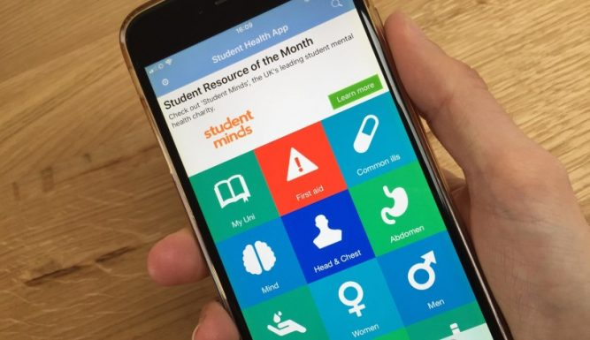
Online services:
NHS App
order repeat prescriptions
share your Covid-19 Status view test results,
book and manage appointments get health information
NHS Number
Student Health App
Free self-help app designed for students
Available from app stores for Apple Android devices –search STUDENT HEALTH APP – Expert Self Care
Gives advice on common illnesses seen in students , how you can treat yourself and where to seek advice and help if needed.
Togetherall - 24/7 peer and professional support
24/7 peer and professional support (with trained healthcare professionals online at all times)
a range of wellbeing courses and tools to help people self-manage their wellbeing.
Click here to register with Togetherall now

Slide 8
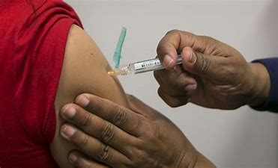
Vaccinations advised (free)
Covid-19 – recommend all students have full dose
https://www.exeter.ac.uk/coronavirus/students/testing/
Meningitis ACWY – all students < 25 years old – phone to book appointment .
Mumps, Measles, Rubella ( MMR ) need two jabs to be protected – book appointment at your registered Health Centre
Flu (influenza) for some medical conditions
Watch for email message in October.
Especially important this year.
You can book a private vaccination
at major chemists.

Slide 9

Staying Healthy and Prepared
Look after yourself, healthy eating get regular sleep!
Expect to get colds and coughs – ‘fresher’s flu’.
But… contact university Covid Rapid Response Hub for test if symptoms of fever / cough / loss of smell or taste.
Speak to your doctor if you take regular medication for a long-term condition.
Keep some medicines and basic supplies in your room
Painkillers , cold remedies , diarrhoea treatment and some food supplies
Ensure you have enough prescribed medication in case need to isolate
Keep us informed
If you are unwell and need to take time off from
your studies please let your Information Point
or the Hub in your college building know.

Slide 10
Looking after your mental health
Adjusting to a new culture can take time. Take time to adjust to your new space
Have some familiar things around you
Familiar food
Take some exercise. Online, on your own, outside – whatever works for you!
Regular contact with friends and family can be beneficial
Make friends here – why not sign up for Global Chums mentor, come along to our Intercultural Café of Connections Café or join a society
Most important: Take advantage of help offered
It’s not a failing to ask for help.
It can be confidential, online or face to face and it can
make a difference to you personally and your studies.
Wellbeing Team
Exeter Penryn
Residence Life
Exeter Penryn
Academic Hubs

